Slide 1
CSCIU 210 Computer Organization AKM Jahangir A Majumder, PhD
Fall 2018 - Lecture 11
September 19, 2018
Note: Some slides are adapted from those used by previous instructors and some slides include figures from the textbook.

Slide 2
Review and Learning Outcomes
We will continue to cover Number Systems
So far, we covered the following topics
Fundamental digital blocks: AND, OR, and NOT gates
Boolean algebra
Base conversion between different number bases
We will begin to cover how to do math in the binary format and how to implement it in hardware
The binary math we learn will be used to build arithmetic logic unit (ALU)
Homework 2 is due today at the beginning of the lecture (Hard Copy)
We will have quiz 2 on Friday, September 21, which will cover lectures 5-9

Slide 3
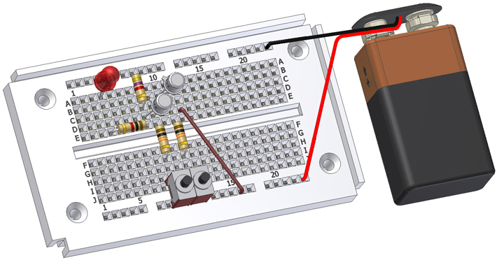
The Breadboard
This presentation will
Explain what a breadboard is.
Identify reasons for using a breadboard.
Review the guidelines and tips for proper breadboarding.
Notes:
Introductory Slide / Overview of Presentation

Slide 4
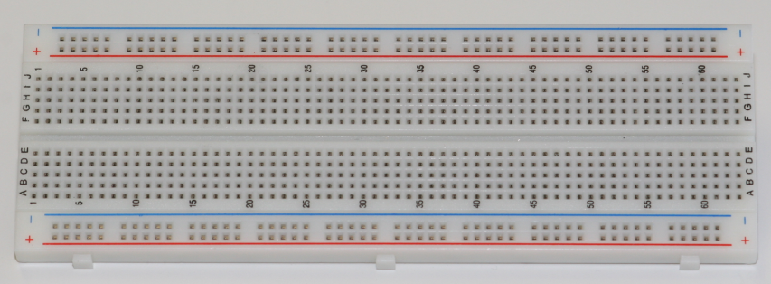
What is a Breadboard?
A breadboard, sometimes called a proto-board, is a reusable platform for temporarily built electronic circuits.
Notes:
Explanation of what a breadboard is.

Slide 5
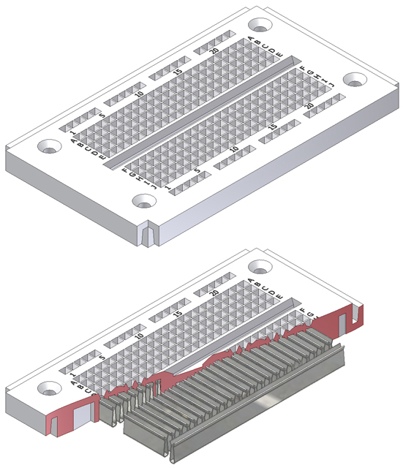
How a Breadboard Works
Electric component leads and the wire used to connect them are inserted into holes that are arranged in a grid pattern on the surface of the breadboard.
A series of internal metal strips serve as jumper wires. They connect specific rows of holes.
Top View
Cut-Away View
Notes:
Overview of how a breadboard works.

Slide 6
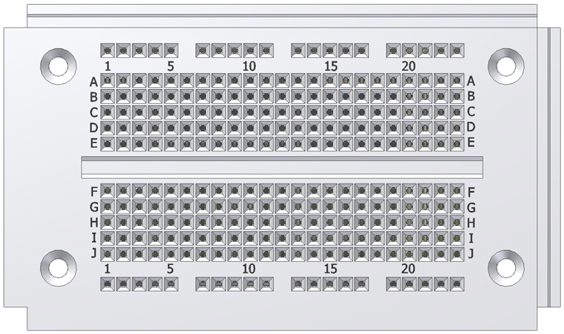
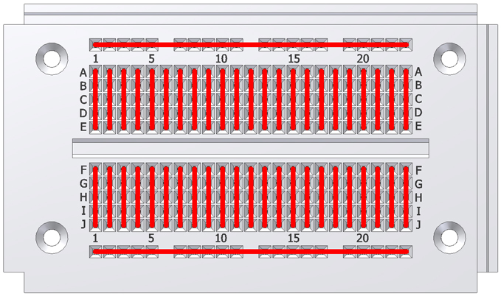
Breadboard Connections
Notes:
An overview of how the breadboard holes are interconnected.

Slide 7
Why Breadboard?
It takes less time (and money) to breadboard a circuit than to design and fabricate a printed circuit board (PCB).
As a complement to circuit simulation, breadboarding allows the designer to see how, and if, the actual circuit functions.
Breadboards give the designer the ability to quickly change components during development and testing, such as swapping resistors or capacitors of different values.
A breadboard allows the designer to easily modify a circuit to facilitate measurements of voltage, current, or resistance.
Notes:
Give the reasons for using a breadboard.

Slide 8
Resistors and Ohm’s Law
ρ
A
L
R: Resistance. An element’s ability to resist electric current flow, measured in ohm (Ω)
L: Material length (meter)
A: Cross-section area (meter²)
ρ: Resistivity of material (Ω-meter)

Slide 9

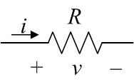
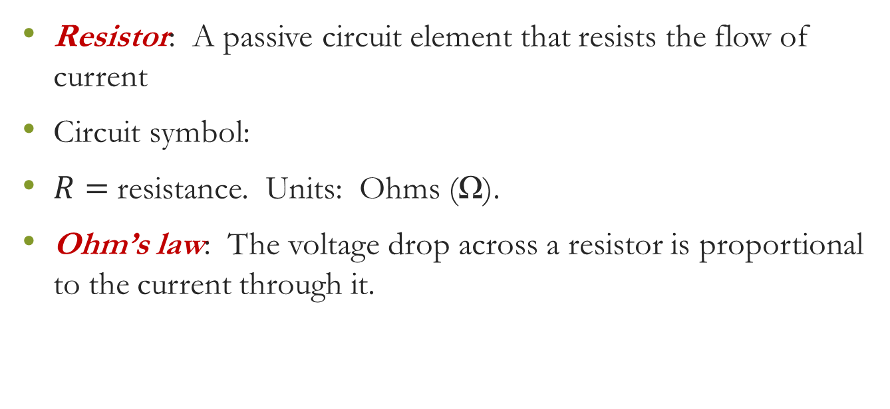

Resistors and Ohm’s Law: Continue
Resistor: A passive circuit element that resists the flow of current
Circuit symbol:
$R=$ resistance. Units: Ohms (Ω).
Ohm’s law: The voltage drop across a resistor is proportional to the current through it.
$$v=Ri$$

Slide 10


Capacitors (Caps)
A capacitor is a passive circuit element that is capable of storing energy
Circuit symbol:
$C$ is called the capacitance of the capacitor
Unit of capacitance: Farad (F). 1 F = 1 C/V

Slide 11


Inductors
An inductor is a passive circuit element that is capable of storing energy
Circuit symbol:
$L$ is called the inductance of the inductor
Unit of inductance: Henry (H). 1 H = 1 V·s/A

Slide 12
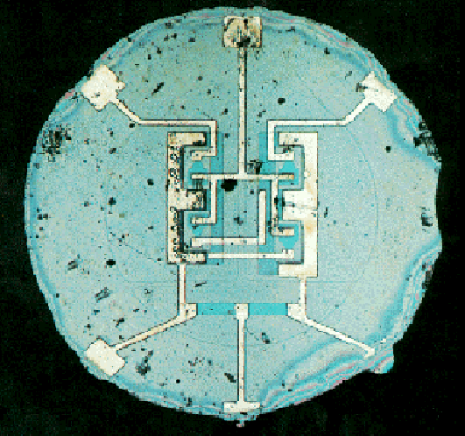

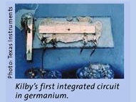
The Integrated Circuit (IC)
An IC consists of interconnected electronic components in a single piece (“chip”) of semiconductor material.
In 1958, Jack S. Kilby (Texas Instruments) showed that it was possible to fabricate a simple IC in germanium.
In 1959, Robert Noyce (Fairchild Semiconductor) demonstrated an IC made in silicon using SiO₂ as the insulator and Al for the metallic interconnects.
The first planar IC
(actual size: 0.06 in. diameter)

Slide 13
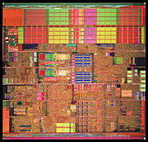
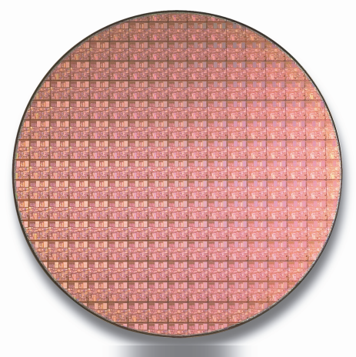
From a Few, to Billions
By connecting a large number of components, each performing simple operations, an IC that performs very complex tasks can be built.
The degree of integration has increased at an exponential pace over the past ~40 years.
The number of devices on a chip doubles
every ~18 months, for the same price.
Intel Pentium®4 Processor
“Moore’s Law” still holds today.
300mm Si wafer

